Slide 1
Creating a Chess Bot with
Tensor Flow
Do chess engines dream of electric pawns?
Guillermo Contreras

Slide 2
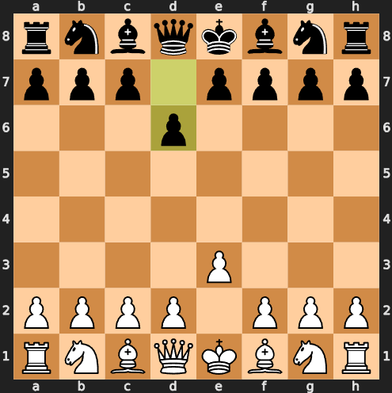
The game of chess
Objective: checkmate the opponent's king
Played on a chessboard with 64 squares
Today's chess engines are significantly stronger than the best human players

Slide 3
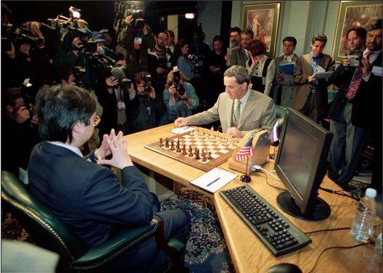
The dawn of computer chess
In 1997, Deep Blue became the first computer to beat the reigning World Champion, Garry Kasparov, in a match.
This engine used custom hardware to allow parallel processing.
It based its play ability on brute force.

Slide 4
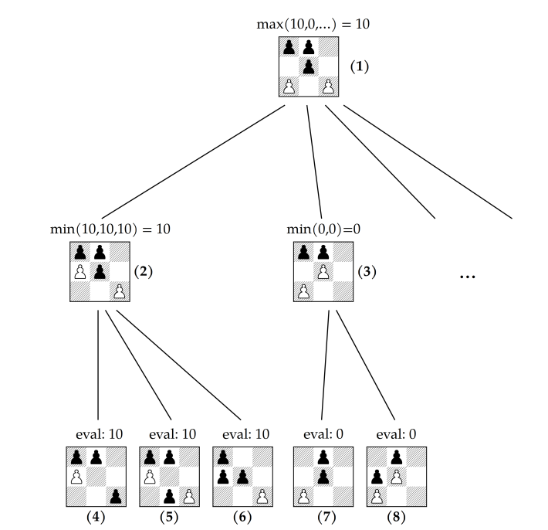
Chess logic
Many possibilities for coding chess logic: many different engines
Find possible moves
Evaluate those moves
ALGORITHM ≈ SEARCH + EVALUATION

Slide 5
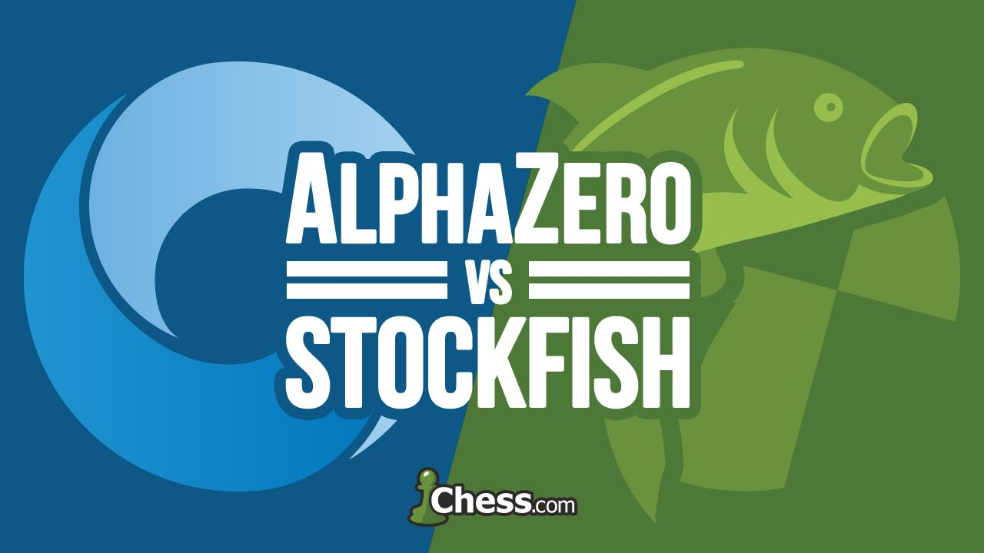
Chess engine logic: two main approaches
Evaluation: Neural network
Search: Monte Carlo Tree Search
Evaluation: Handcrafted Evaluation function (knowledge about chess)
Search: Minimax function with alpha beta pruning

Slide 6
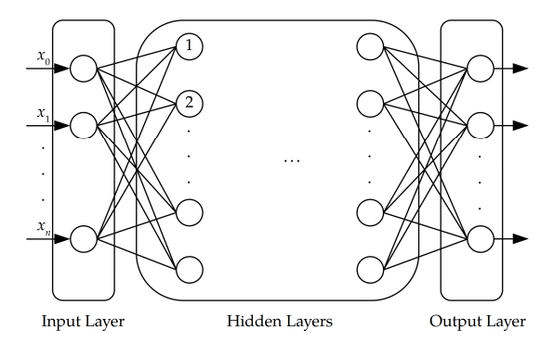
ALPHA ZERO’s approach:
Using neural networks to evaluate a position
Pattern recognition!
We encode different information about the chessboard, pieces, rules as inputs and the network tries to find patterns

Slide 7
My Goal:
Create a chess bot that uses a neural network that can evaluate positions

Slide 8
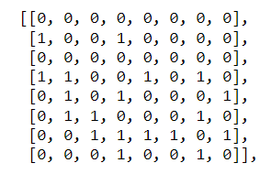
Chess bot eval function
14
INPUT:
position of each type of piece for white/black and the available squares for those pieces: 14 layers ALPHAZERO → 119 layers!!!
8
8

Slide 9
The chess bot: evaluation function
Dataset
~ 900k positions and evaluation from stockfish
INPUT
3d matrix of
8 x 8 x 14
MODEL
neural network (2 conv layers)
OUTPUT
evaluation

Slide 10
Bot game logic
Select all possible positions: use minimax search
Minimax uses my model to evaluate each position
Make a move

Slide 11
DEMO!

Slide 12
Challenges/improvements:
The model has not been tested. The amount of training data in order to get a good neural network is many times the size of what I used and still requires a big computational effort, not suited for normal computers.
Implement reinforced learning
Other rules need to be coded, this is much more trial/error and research from other engines.

Slide 13
Thank you!

